Slide 1
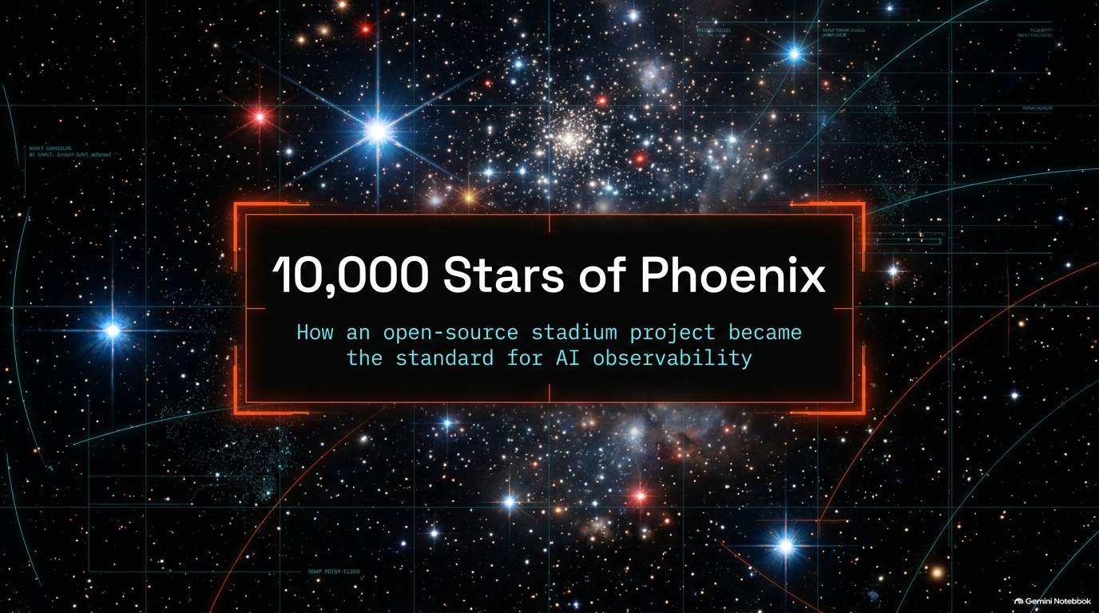
Notes:
Opening & Welcome: Welcome everyone. Today, we’re celebrating a huge milestone: Phoenix passing 10,000 GitHub stars. But more than a star count, this is the story of how an open-source "stadium project" became the standard for AI observability.
The "Stadium Project" Ethos: When you look at massive platforms, you might imagine a giant enterprise floor with hundreds of engineers. Phoenix was built by a lean core team of just 6 to 7 engineers. We call this a stadium project—a tiny team building the infrastructure that thousands of developers and enterprise teams run on globally every single day.
The Core Problem: Why did we build Phoenix? In late 2022 and early 2023, as teams moved from traditional ML to generative AI, a deep trust deficit emerged between practitioners and traditional black-box enterprise AI vendors. Developers didn't trust closed systems to handle their raw prompts or unstructured text payloads.
The Solution: The antidote to this trust deficit was radical transparency, rapid feedback loops, and bypassing six-month corporate procurement cycles entirely. Engineers could pip install Phoenix and gain immediate, local visibility into their LLMs and RAG pipelines without sending data to third-party SaaS servers.
How Phoenix became the standard for AI observability
https://www.youtube.com/watch?v=osTNToMfiBo

Slide 2
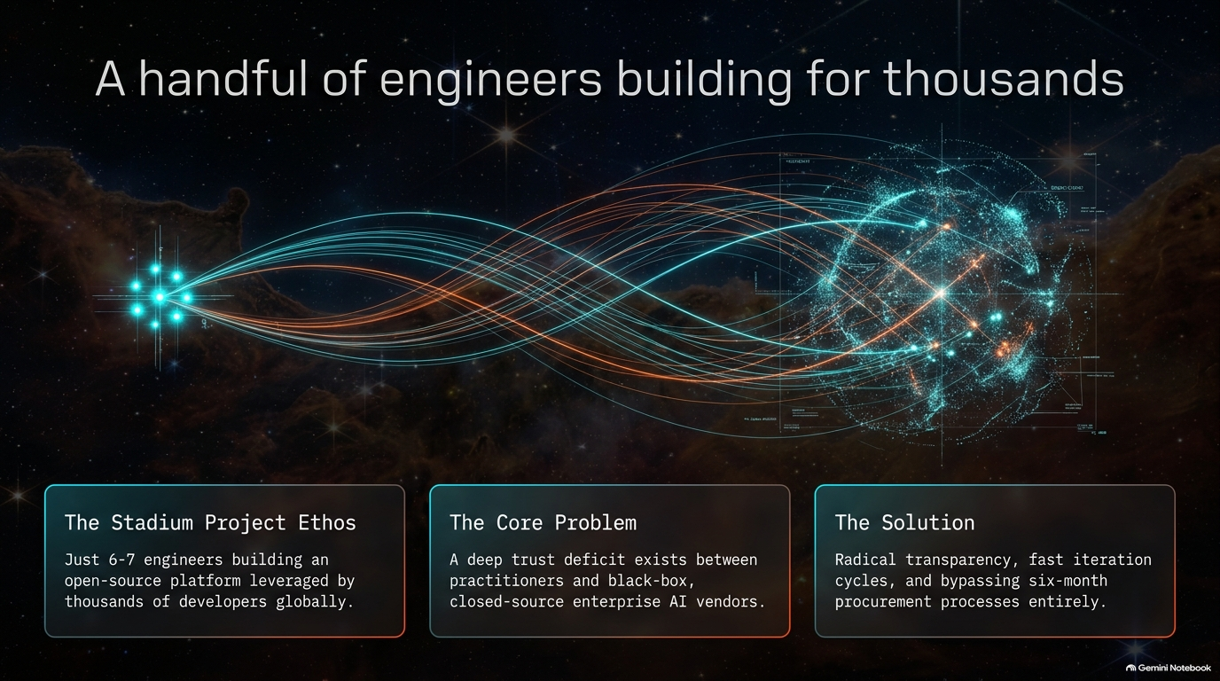
Notes:
The Catalyst: When GPT-3 and ChatGPT dropped, traditional DevOps and ML metrics (like mean squared error or simple latency histograms) suddenly failed. Understanding modern AI required a completely new paradigm: visualizing unstructured text, complex prompts, and conversational memory in real time.
The Technical Breakthrough: In the early days of Arize's open-source effort, our team was experimenting with clustering techniques. The major "aha!" moment happened when engineer Roger Yang successfully wired up UMAP and HDBSCAN to project high-dimensional text embeddings into interactive 3D point clouds. For the first time, developers could literally see the clusters and topic drift inside a chatbot’s inner workings.
The Ecosystem Pivot: As RAG (Retrieval-Augmented Generation) frameworks like LlamaIndex began taking off, we realized that developers urgently needed to inspect the exact retrieved context payloads powering their LLM pipelines. Visualizing these vector embeddings became our immediate pivot point.

Slide 3
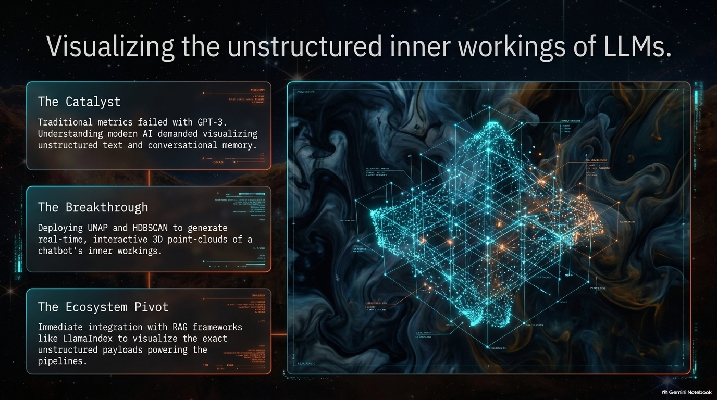
Notes:
The Architecture Paradox: Traditional SaaS applications follow a predictable software engineering blueprint:
Set up a database.
Build containerized services.
Implement authentication and RBAC.
Finally, build UI features.
The Phoenix Flow: Phoenix flipped this model entirely upside-down:
Step 1: Features First (2023): We started strictly inside a Jupyter notebook extension focusing on pure, immediate visibility for RAG pipelines.
Step 2: Containerization: Users were leaving notebooks running for days with millions of telemetry spans. To escape the notebook environment, we published a Docker container before we even had a persistence layer, letting users export traces to custom setups like ElasticSearch or Mongo.
Step 3: Local Persistence: Community demand forced us to build structured local persistence using SQLite for lightweight local workflows and PostgreSQL for enterprise scale.
Step 4: Enterprise Security: Enterprise users loved the tool but required auth. We implemented Keycloak, OIDC, and custom auth layers as the final step.
Key Takeaway: Building software "backwards" ensured that every architectural layer added was directly pulled by real user demand rather than pushed by PM assumptions.

Slide 4
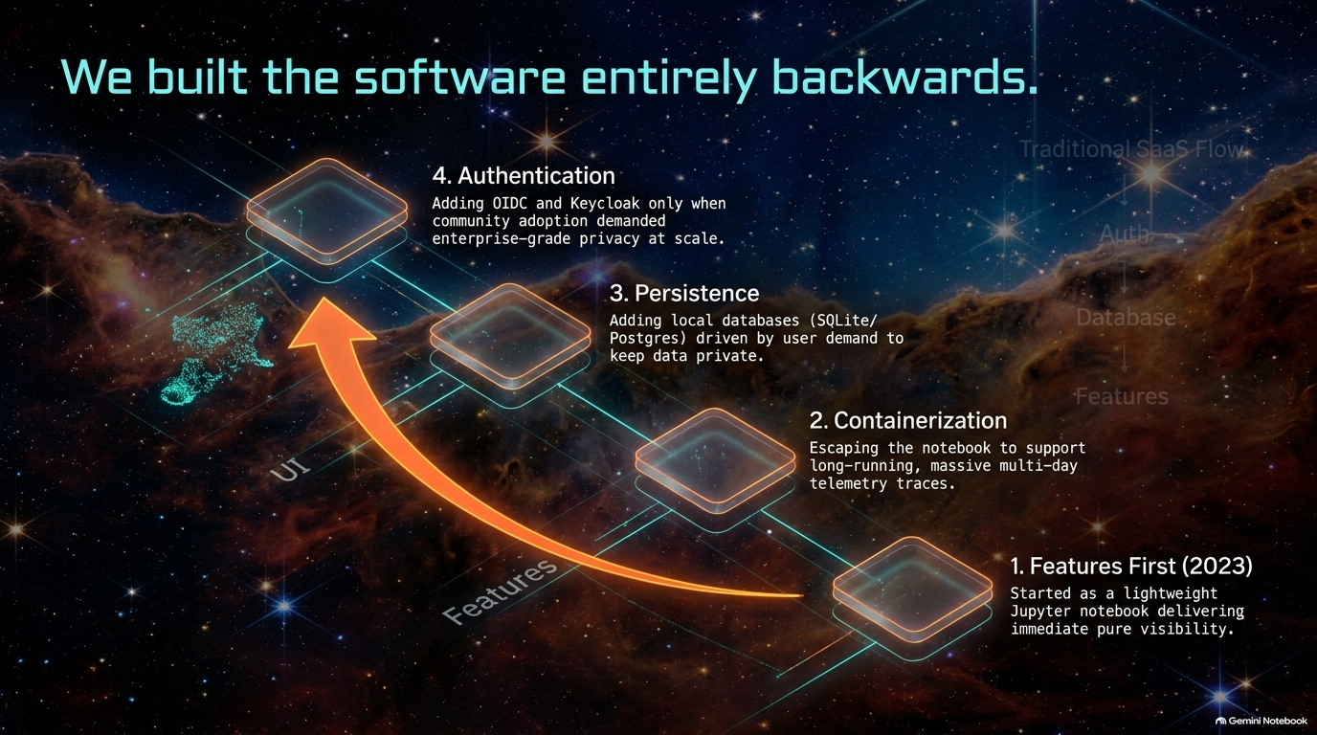
Notes:
The Happy Accident: Because Phoenix was born as a notebook extension, running locally wasn't initially a grand strategic masterplan—it was a technical necessity. However, this "happy accident" turned into our biggest enterprise superpower.
Zero PII Leakage: Generative AI trace payloads contain sensitive prompts, proprietary knowledge base documents, and user memory. A local-first stack guarantees that sensitive data never leaves the practitioner's local machine or corporate VPC.
Air-Gapped & Locked-Down Environments: We were surprised by the massive influx of support requests from enterprise Windows users operating in heavily restricted corporate environments. Phoenix gave them full-featured observability without needing external cloud connectivity or security sign-offs.
Zero-Cost Developer Velocity: Why pay variable SaaS pricing per span while locally debugging code? Phoenix allows an enterprise to equip 400+ engineers with full observability stacks locally at zero marginal SaaS commodity cost.

Slide 5
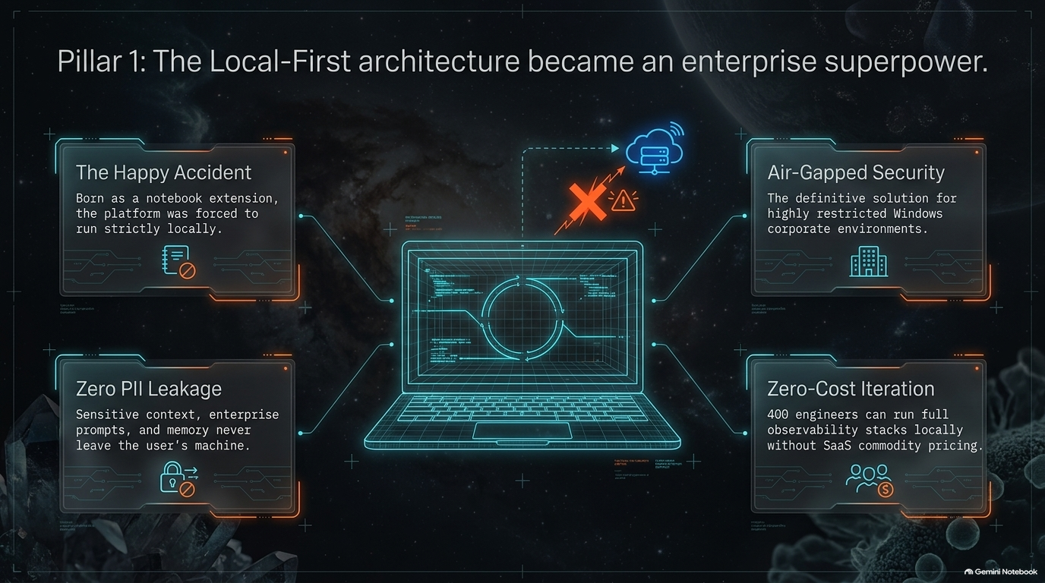
Notes:
The Architectural Split: As we deepened tracing capabilities, we faced an internal engineering debate: Can standard DevOps plumbing (like OpenTelemetry) handle AI workload telemetry?
Traditional DevOps (Standard OTel):
Designed for system signals, discrete microservice events, network latency, and millisecond timings.
Deals primarily with small key-value pairs and HTTP response codes.
AIOps (The New Frontier):
Involves heavy multimodality, dense PII, massive text payloads (paragraphs of prompts and contexts), and high-dimensional vector embeddings.
The Friction: Standard telemetry collectors are optimized to drop or trim large payloads to save network overhead. AI observability requires preserving these multi-kilobyte payloads intact so engineers can debug prompt engineering and context retrieval failures.

Slide 6
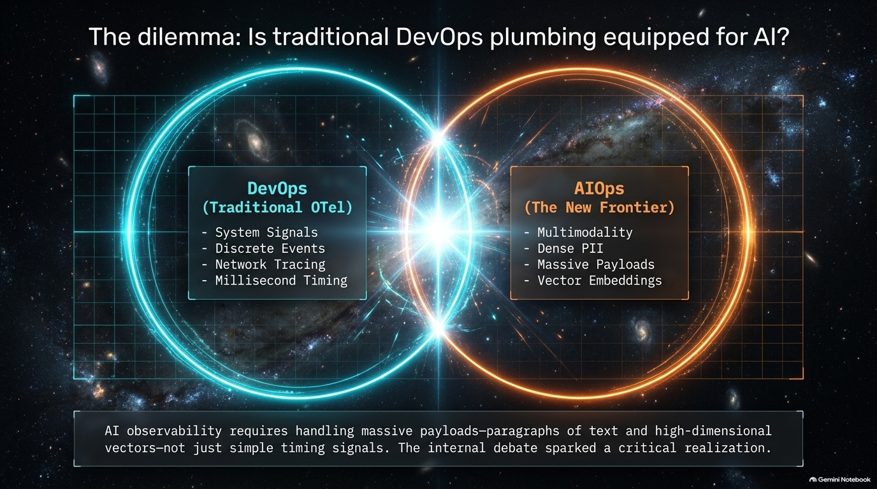
Notes:
The Pivotal Pull Request: Initially, we built a custom internal tracer. Over a weekend, Roger Yang opened a PR mapping our rich AI trace payloads directly to OpenTelemetry standards. While met with initial internal skepticism, it proved the hidden flexibility of OTel. Universal Cross-Language Reach: Standardizing on OTel instantly eliminated language barriers. A maintainer writing LangChain in Go or an enterprise building in Ruby can stream traces straight to Phoenix using native OpenTelemetry exporters without waiting for Python-only updates. DevOps ARE AIOps Problems: AI applications don't live in a vacuum. When an LLM application fails, it's often due to classic DevOps issues like DNS resolution failures, rate limits, or network timeouts contacting API endpoints (e.g., OpenAI outages). A unified OTel pipeline bridges software engineering with AI engineering.

Slide 7
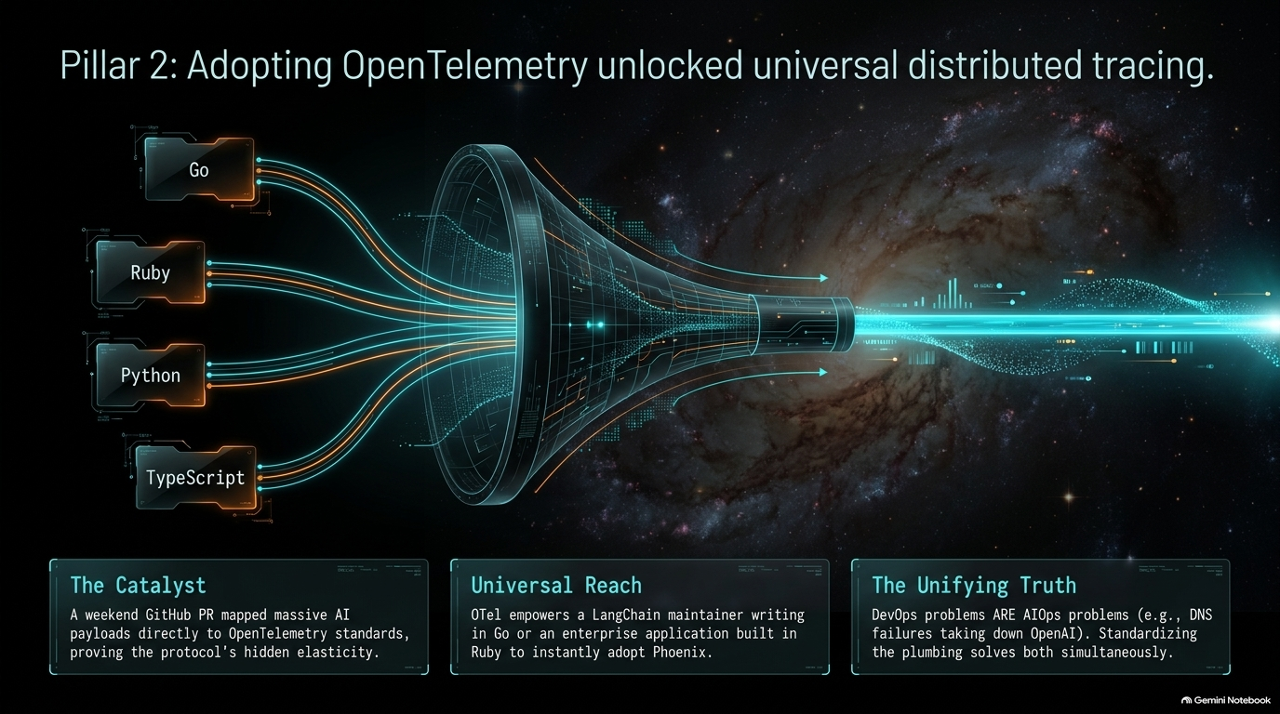
Notes:
Bridging the Semantic Gap: OpenTelemetry provided the standard transport pipes, but it had no native vocabulary to describe LLM concepts like prompts, completions, vector retrieval, or agent tool calls.
Introducing Open Inference: We created the Open Inference specification as an open, vendor-neutral semantic convention. It translates raw, unformatted LLM outputs into structured, queryable telemetry span attributes:
Prompt and completion token counts.
Reranking scores and vector retrieval distance metrics.
Agent tool selection and execution parameters.
Spec + Instrumentation Co-location: By co-locating the Open Inference specification directly alongside the instrumentation packages in our monorepo, we empowered community practitioners to ship rapid two-week updates as agent patterns evolved.

Slide 8
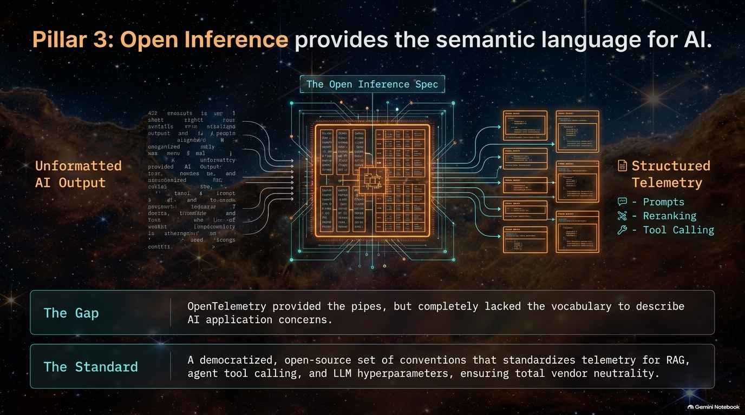
Notes:
Complete Framework Neutrality: Phoenix sits neutrally between orchestrators (LlamaIndex, LangChain) and LLM providers (OpenAI, Anthropic, Hugging Face).
No Vendor Lock-In: Practitioners are not forced into proprietary SDKs. Phoenix instruments both Python and TypeScript stacks across any model back-end.
The Scientific Playground for Evals: Early on, nobody knew definitively what a "good" LLM evaluation looked like—whether it was G-Eval, ROUGE scores, or embedding similarities. Phoenix was designed as an open experimental playground where the community could objectively test, benchmark, and establish evaluation standards.
Truth Over Dogma: We don't mandate how teams evaluate their systems; we provide the trusted medium to capture and analyze the ground truth.

Slide 9
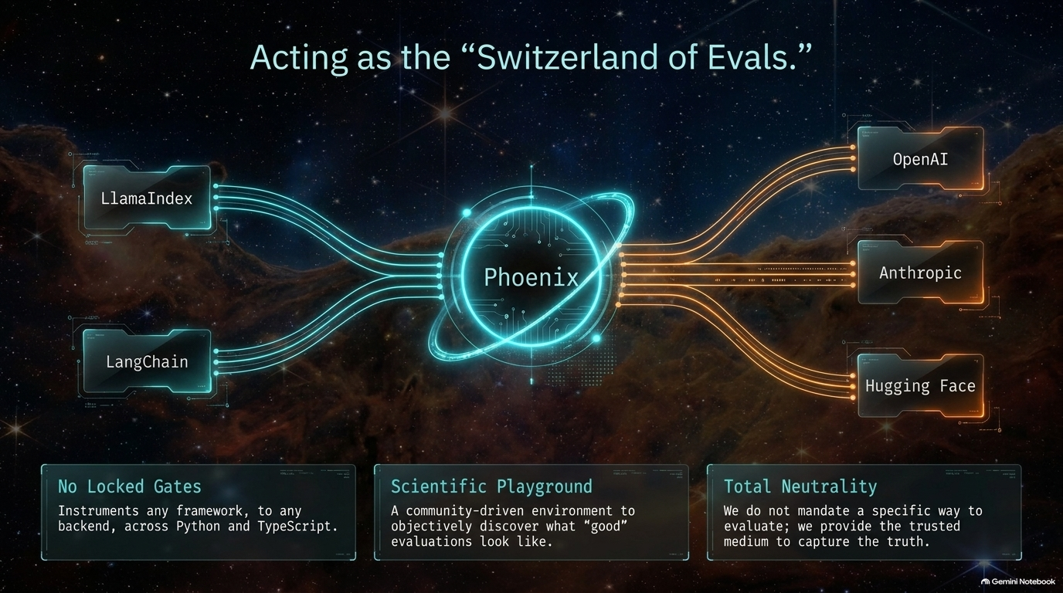
Notes:
Complementary Roles: People often ask how Phoenix relates to Arize’s commercial enterprise platform, Arize AX. They are built to complement each other across different operational scale boundaries:
Phoenix (Open Source):
Practitioner-focused, agile, and reach-optimized.
Runs local-first (SQLite) or containerized (Postgres) in air-gapped environments.
Functions as an agile "Skunkworks" OTel collector and rapid evaluation testing bed.
Arize AX (Enterprise Platform):
Revenue- and compliance-optimized for global enterprises.
Deployed on cloud infrastructure or large-scale enterprise data warehouses.
Handles massive long-term data retention, enterprise RBAC, and SOC-2 compliance.
The Synergy: Phoenix captures telemetry at the developer's local edge; AX aggregates and scales it across enterprise production fleets.

Slide 10
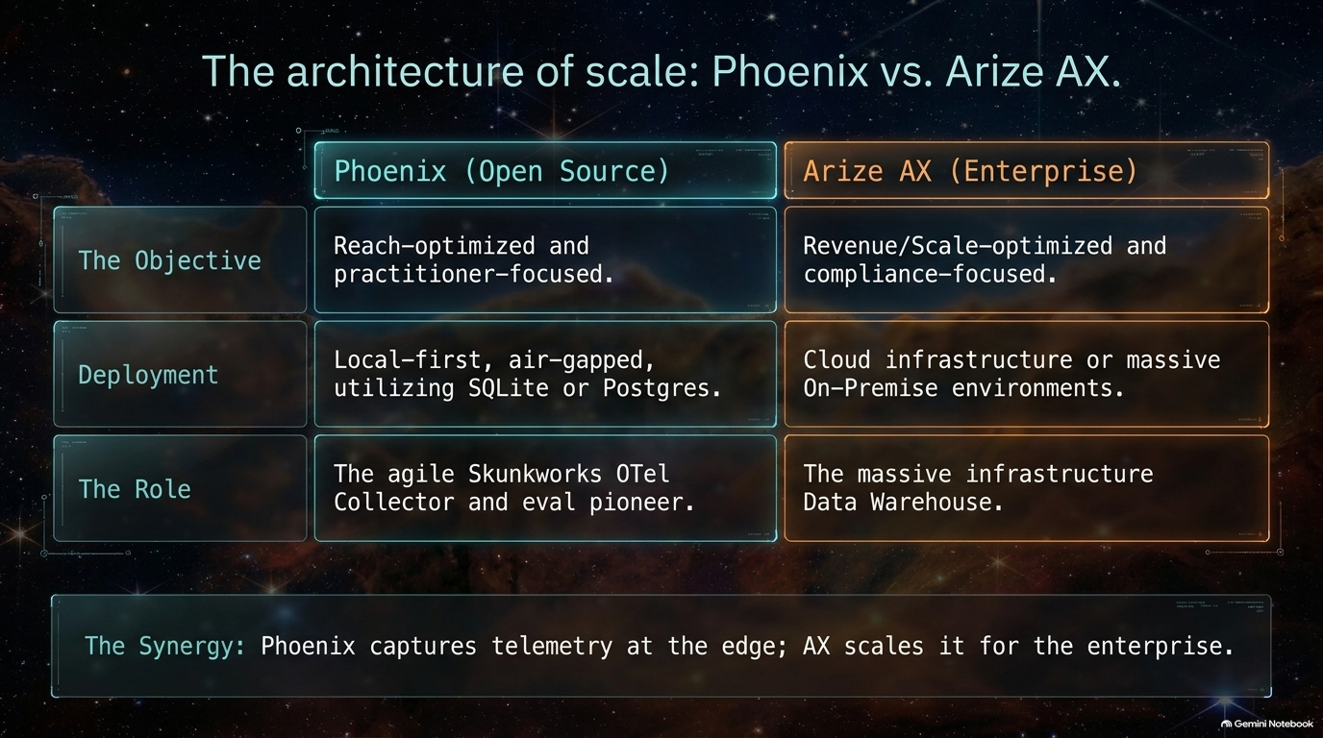
Notes:
Bringing the Core Pillars Together: Building robust, non-deterministic AI applications requires three foundational elements operating in unison:
Local Privacy (The Fortress): Zero PII leakage and local-first execution.
Standardized Plumbing (OpenTelemetry): Cross-language distributed tracing across modern microservices.
Rich Semantic Context (OpenInference): Structuring prompts, agent steps, and retrieval payloads.
The Modern AI Software Factory: When these three pillars interconnect around an Agent Engine, developers gain the feedback loops needed to audit, evaluate, and iterate on complex non-deterministic software safely.

Slide 11
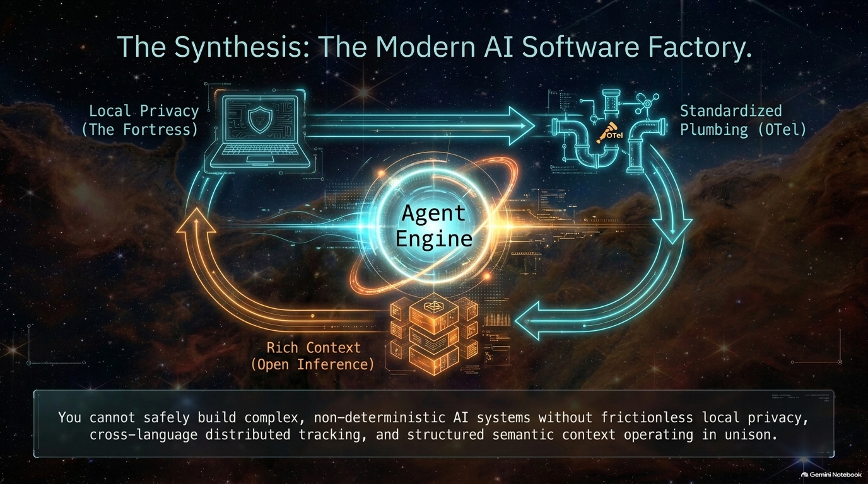
Notes:
The Paradigm Shift: Software engineering is undergoing a fundamental transformation. Developers are moving from hand-writing deterministic code to orchestrating autonomous coding agents like Claude 3.5 Sonnet and GPT-4o.
Agents Writing Agents: As coding agents generate non-deterministic code, they need their own sandboxed observability environments to execute, inspect, and self-correct their work. Engineers are using Git worktrees with multiple isolated Phoenix instances running side by side.
The Phoenix Role in Agent Workflows: Phoenix acts as the local observability sandbox. It injects relevant telemetry context into coding agents and provides auditable trace histories to verify what the agent attempted, what tools it invoked, and where it failed.

Slide 12
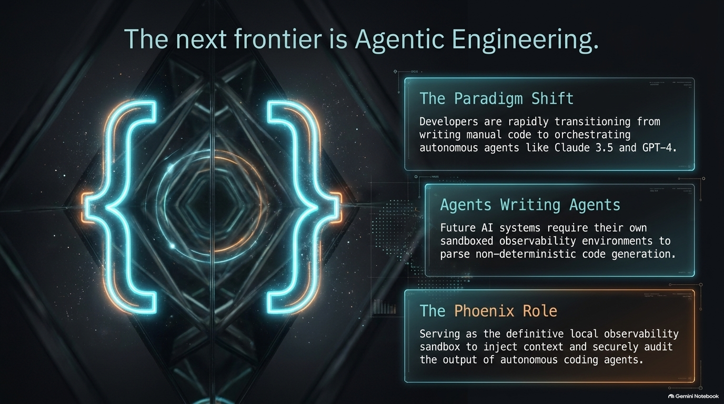
Notes:
The AI Slop Risk: Autonomous coding agents allow teams to generate software at unprecedented velocity. However, unconstrained generation creates a critical risk: shipping vast amounts of unverified, untrackable "AI slop" into production.
The Antidote — Evidence-Based Development: Uncompromising data visibility is the cure. Speed is only valuable when supported by rigorous evaluation and structural discipline.
Operational Mechanisms:
Human-in-the-Loop Permissioning: Ensuring humans review high-impact agent actions.
Scientific Evaluation: Replacing guesswork with systematic benchmark testing.
Complete Auditability: Maintaining end-to-end trace logs for every agent execution step.

Slide 13
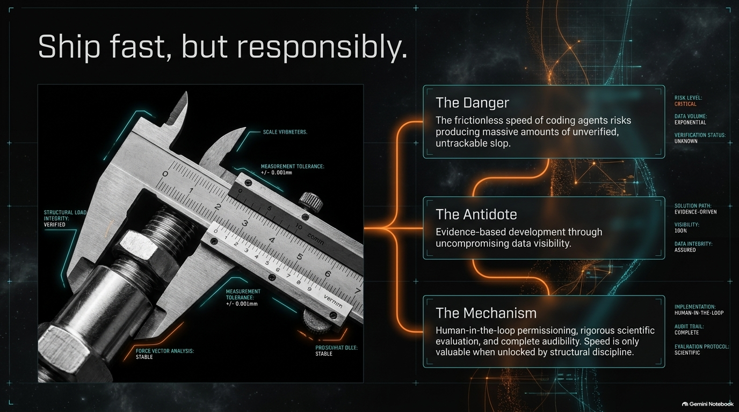
Notes:
No Layer of Distance: The Phoenix core engineering team operates directly on Slack and GitHub without intermediary support layers. When users submit issues or feature requests, they interact directly with the core developers building the platform.
Call to Action:
Contribute: Join us in expanding and defining the Open Inference standard.
Install: Run pip install arize-phoenix locally today to regain immediate visibility into your AI application stacks.
Connect: Participate in community discussions with thousands of practitioners building AI observability in the open.

Slide 14
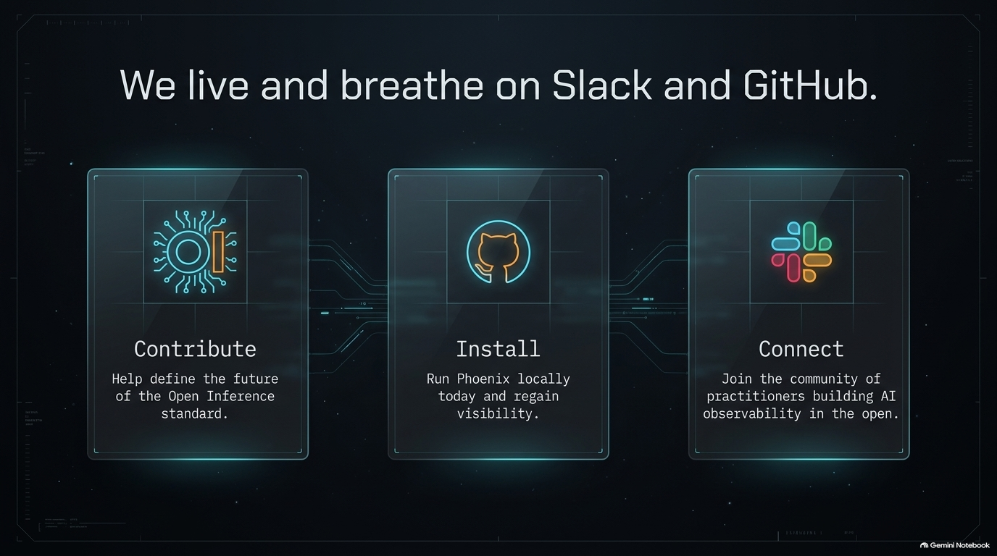
Notes:
A Milestone for Open Source AI: Hitting 10,000 GitHub stars validates the shift toward open, privacy-first, and standardized AI observability.
Community Gratitude: Thank you to every contributor, maintainer, framework partner (LlamaIndex, LangChain, Hugging Face), and practitioner who submitted PRs, reported issues, and helped shape Phoenix into an industry standard.

Slide 15
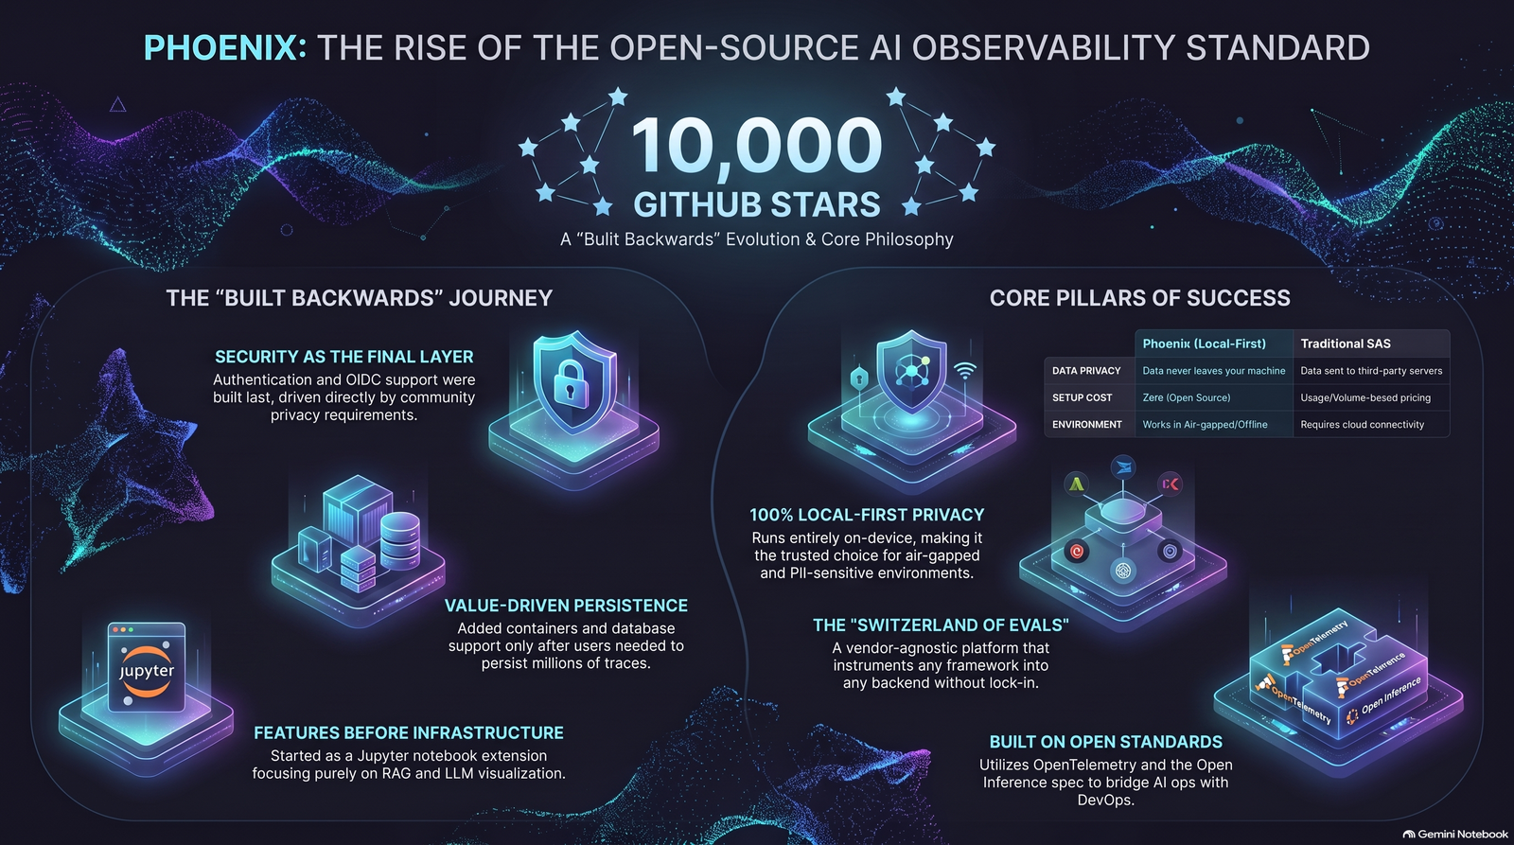
Notes:
Executive Recap:
Built Backwards: Phoenix evolved from a Jupyter notebook extension into a full local/enterprise observability standard by prioritizing practitioner value over traditional SaaS scaffolding.
Local Privacy as a Core Pillar: 100% on-device execution guarantees security for air-gapped corporate environments and sensitive PII.
Open Standards: Built on OpenTelemetry and Open Inference to unify AIOps and DevOps into a single, vendor-neutral language.
Ready for the Agentic Era: Equipping autonomous coding agents and human engineers with the auditable sandboxes required to ship AI applications fast—and responsibly.
How Phoenix became the standard for AI observability
https://www.youtube.com/watch?v=osTNToMfiBo

